Slide 1
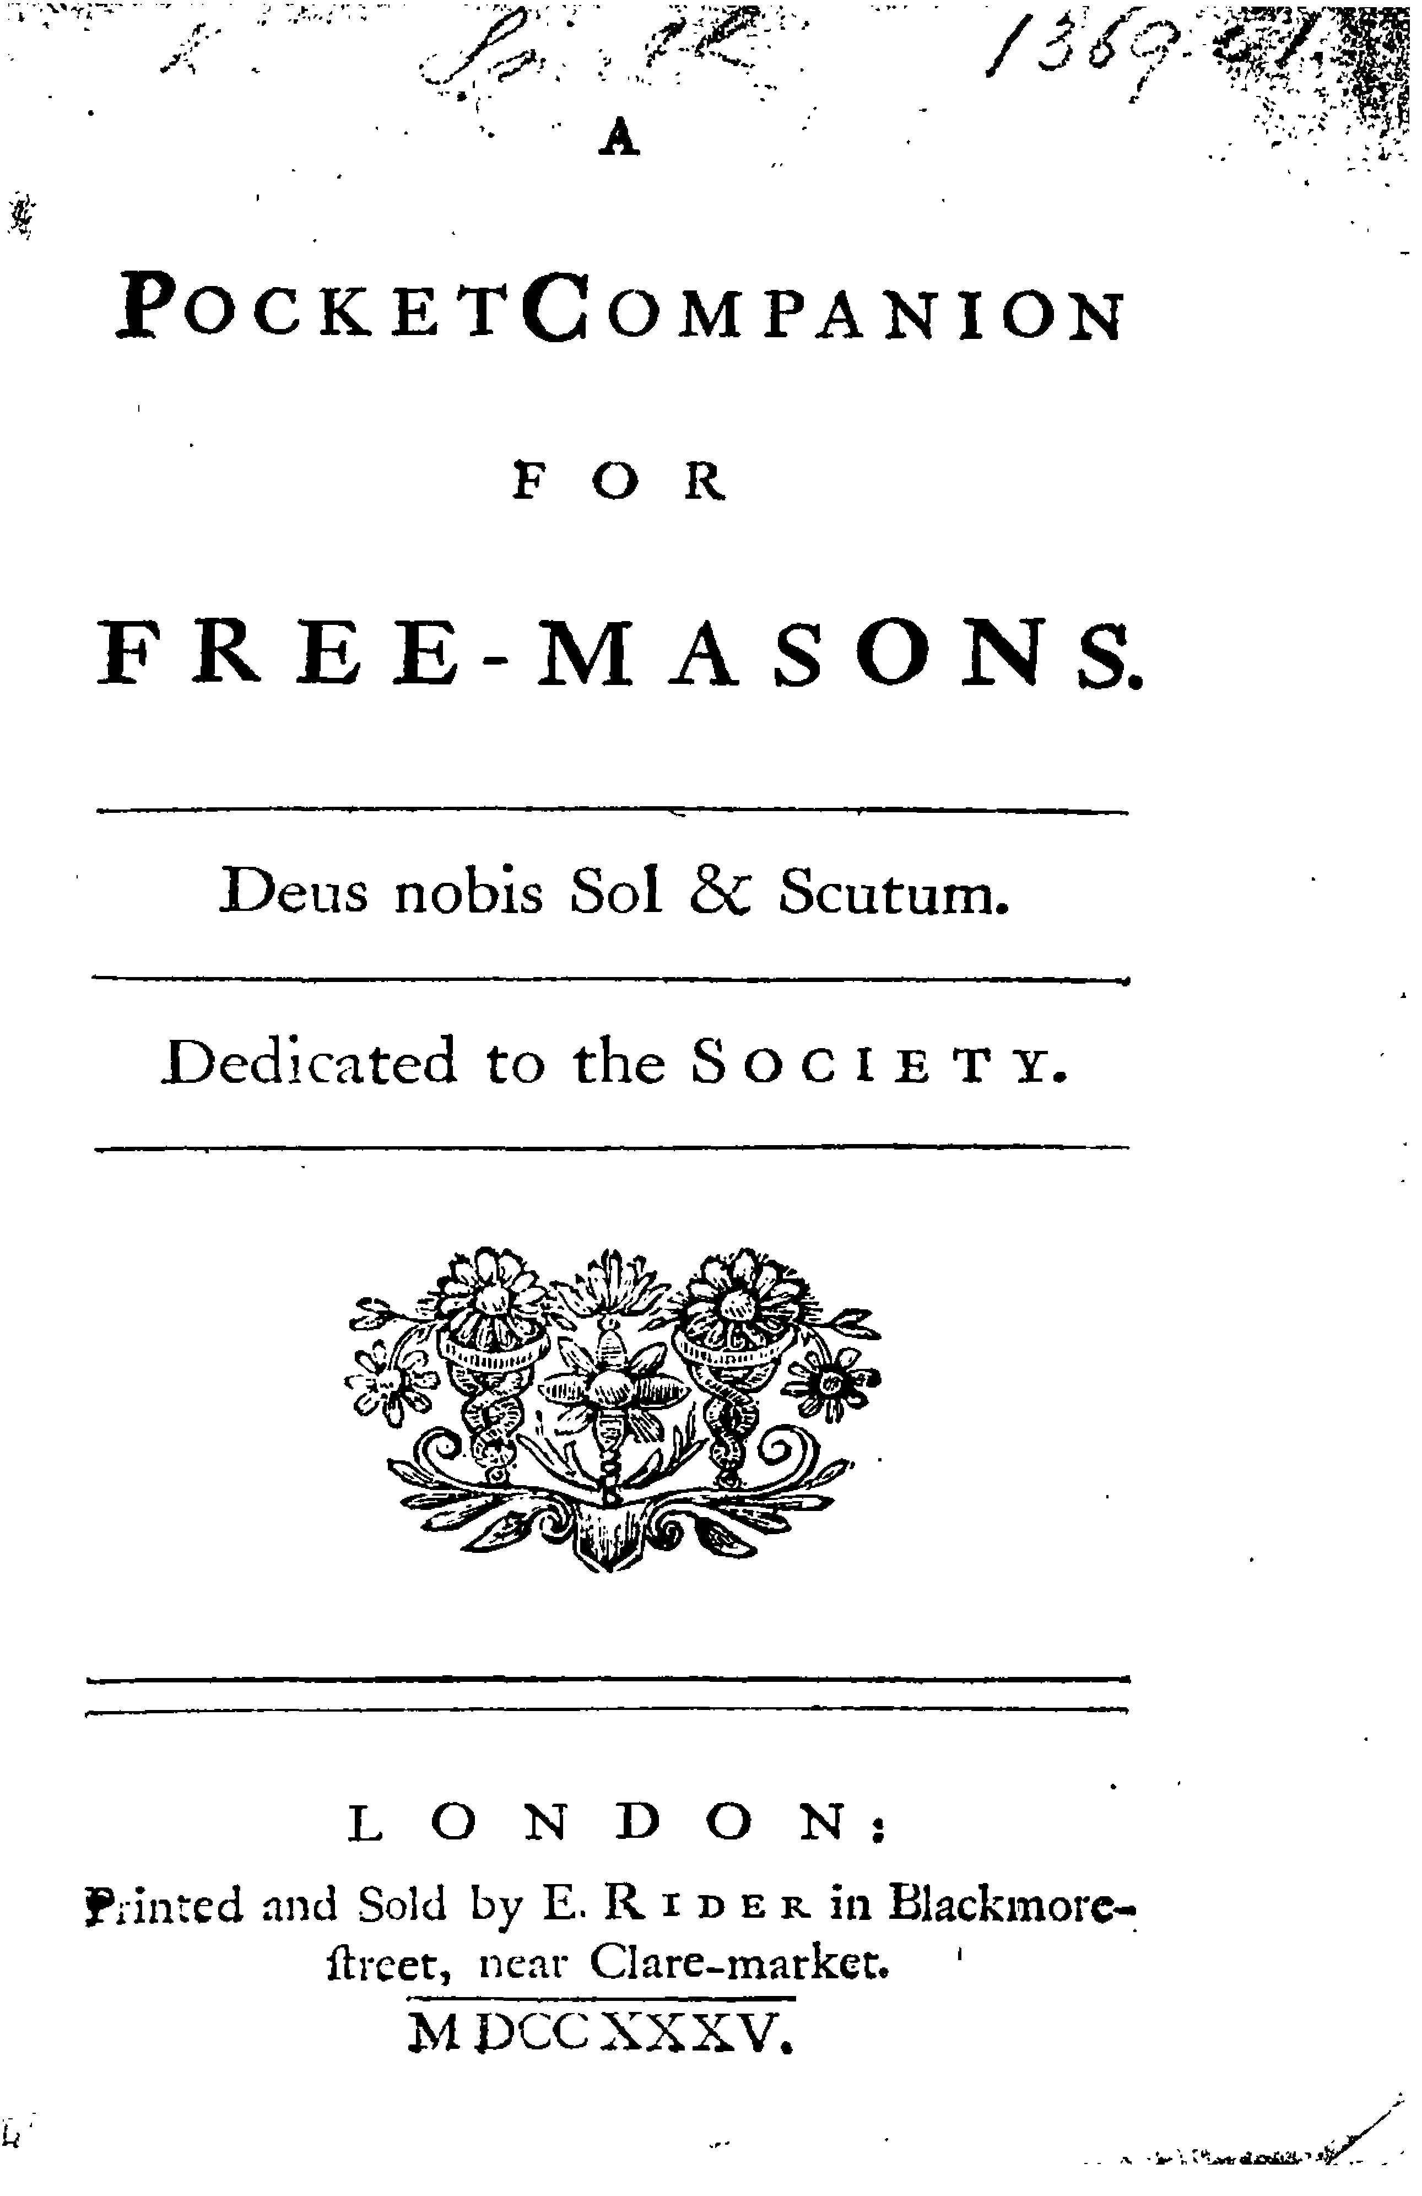
William Smith
and his
Pocket Companions
of 1735
John Belton

Slide 3
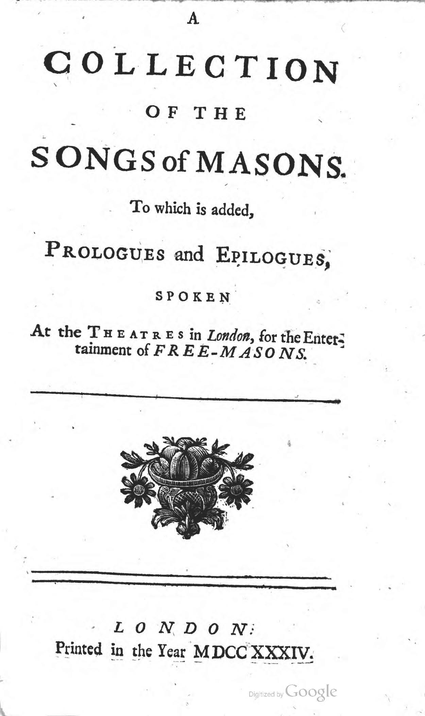

Slide 4
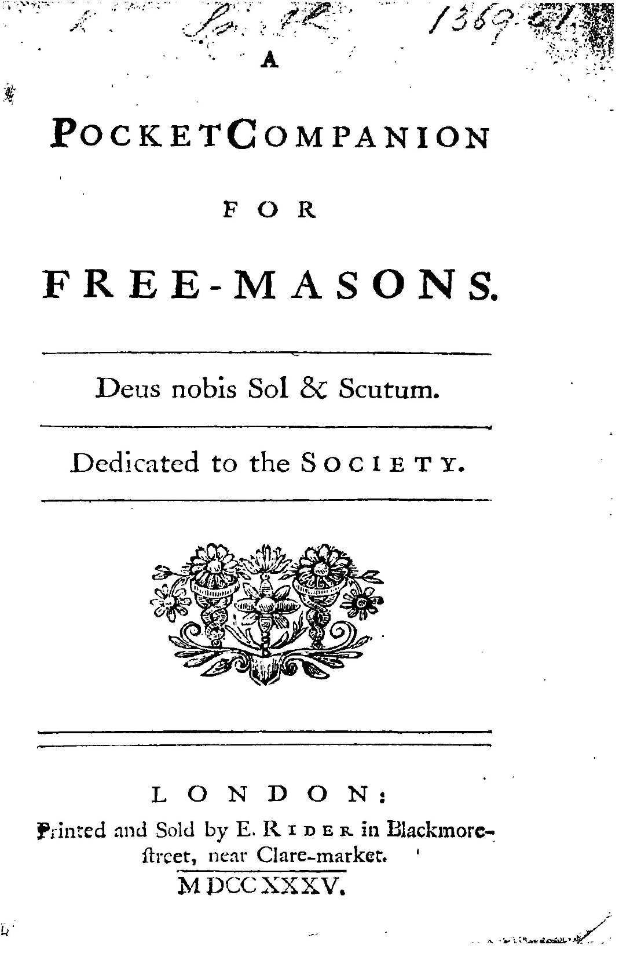

Slide 5
GLE Proceedings - 24 February 1735

Slide 8
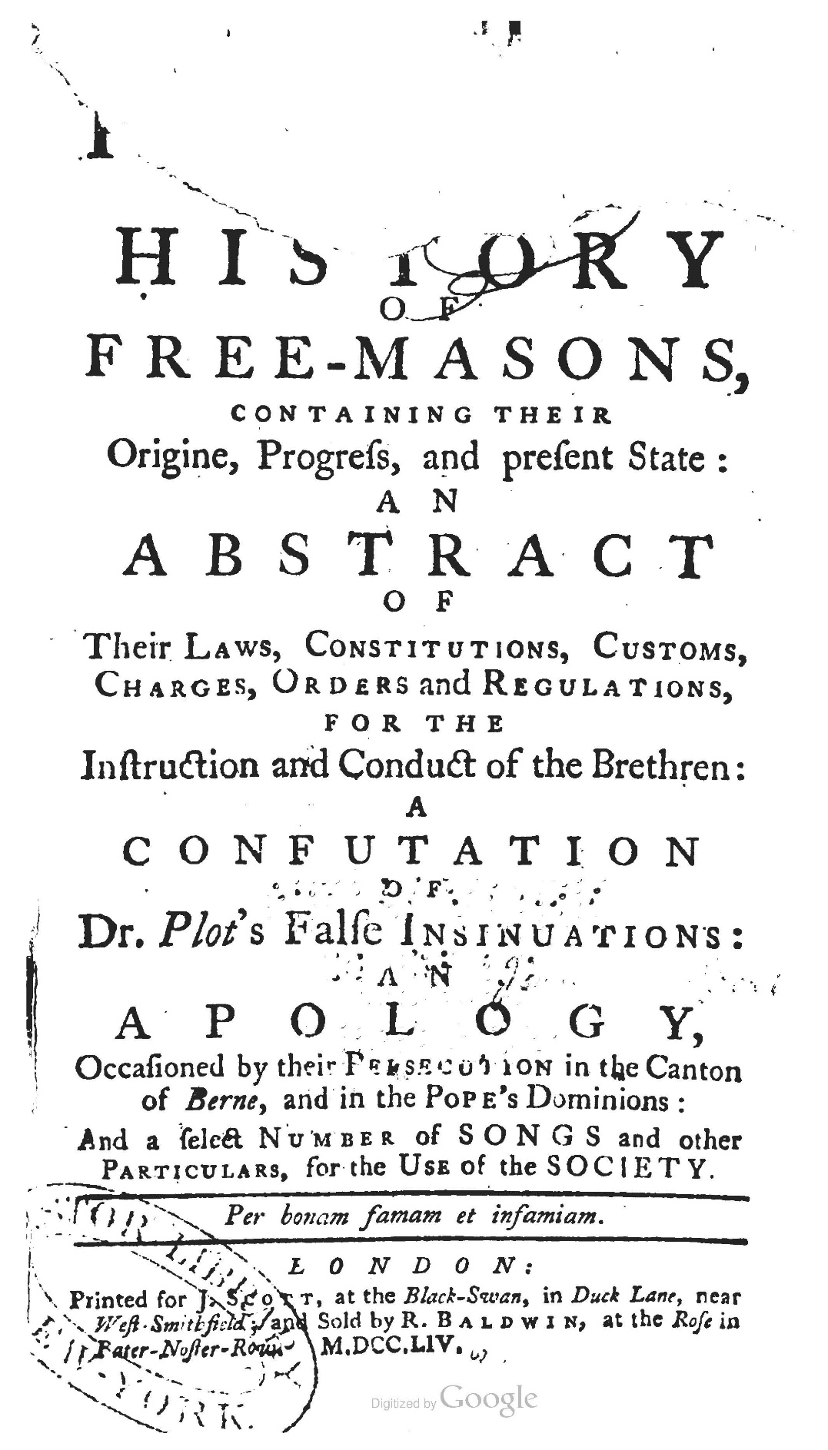

Slide 9
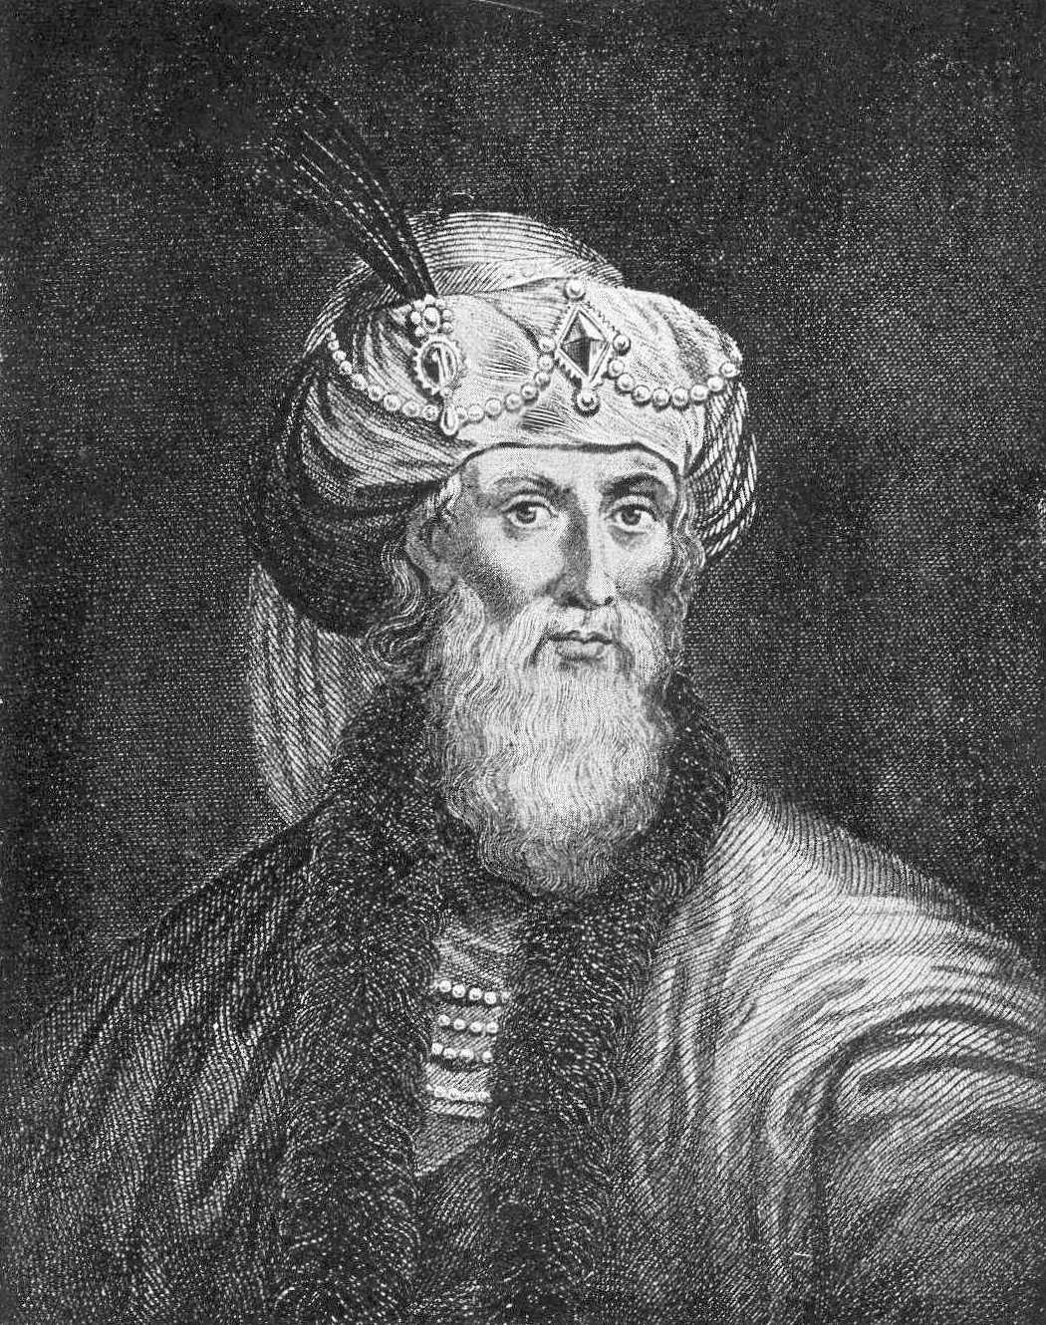
Flavius Josephus
Antiquities of the Jews
93-94 AD

Slide 10
Before I go - A Conundrum
Avant de partir - une énigme
I Of God and Religion
Why did the Moderns and Scotland choose the Anderson 1723 version and the Antients and Ireland chose Andersons 1738 Constitutions with its Noachida version?
Was it something national, social or religious?
Or was it something to do with masonic social demographics in different Grand Lodge?
After all Dermott tells us that he had a wide choice of sources !

Slide 11
Laurence Dermott in Ahiman Rezon 1756

Slide 14
